Slide 1
CSE 3107 Communication Engineering
Dr. Foez Ahmed
Arifa Ferdousi
Zannatul Mifta

Slide 2
Overview
Course Code: CSE 3107
Course Title: Communication Engineering
Credit Hour: 3.0
Total Marks: 100
Course Type: Theory
Pre-requisite: CSE 2207 (Computer Networks)
Year and Semester: 3rd Year 1st Semester
Academic Session: Summer 2025

Slide 3
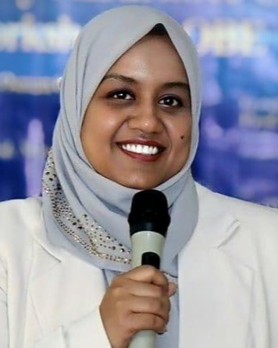

Instructor Details
Name: Arifa Ferdousi
Designation: Lecturer
Department: Information and Communication Engineering
Institution: University of Rajshahi, Rajshahi, Bangladesh
Email: arifa_ice@ru.ac.bd
Cell Phone/WhatsApp: 01313328537

Slide 4


Find your course materials in Teams

Slide 5
Course Outcomes
COs | Description | Taxonomy domain/level | POs | WK | WP | EA | Teaching-Learning strategy | Assessment strategy
CO1 | Describe the necessary terminologies of Communication Engineering. | Cognitive/ Understand | 1 | 3 |  |  | Lecture/Slides | Mid-Term
CO2 | Analyze the analog and the digital modulation techniques. | Cognitive/ Analyze | 2 | 4 |  |  | Lecture/Slides | Class Test
CO3 | Explain Satellite and Optical Fiber Communication | Cognitive/ Understand | 1 | 3 |  |  | Lecture/Slides | Final Exam

Slide 6
Program Outcomes
a) Apply knowledge of mathematics, natural science, engineering fundamentals and an engineering specialization as specified in K1 to K4 respectively to the solution of complex engineering problems.
b) Identify, formulate, research literature and analyze complex engineering problems reaching substantiated conclusions using first principles of mathematics, natural sciences and engineering sciences. (K1 to K4)

Slide 7
Knowledge Profile (K1–K8)
Code | Description
WK1 | Mathematics, science, engineering fundamentals
WK2 | Engineering specialization fundamentals
WK3 | Advanced engineering knowledge
WK4 | Research literature and methods
WK5 | Engineering design
WK6 | Engineering practices, tools, and resources
WK7 | Effects of engineering on society and environment
WK8 | Principles of project management and finance

Slide 8
Course Plan
Week | Topic | Reading Materials
1 | Communication Engineering Fundamentals, Waveforms Spectra, Elements of basic communication systems, Periodic and nonperiodic waveforms and their properties. Fourier series | Data Communications and Networking by Behrouz A. Forouzan, Chapter-3 Lecture Slides
 | Noise and its different types. | Lecture Slides Electronic Communication Systems by George Kennedy, Chapter-2
2 | Analogue Communication: Amplitude modulation, Amplitude modulation index, Frequency spectrum for sinusoidal AM. | Lecture Slides Electronic Communication Systems by George Kennedy, Chapter-2
3 | Frequency Modulation: Frequency Modulation, Sinusoidal FM, Frequency spectrum for Sinusoidal FM, Phase Modulation. | Class Lecture Lecture Slides Electronic Communication Systems by George Kennedy, Chapter-4
4 | Pulse Code Modulation (PCM), Quantization, Compression, PCM Receiver, Differential PCM | Data Communications and Networking by Behrouz A. Forouzan, Chapter-4, Article - 4.2 Lecture Slides Electronic Communication Systems by George Kennedy, Article-5.3.3
5 | Delta Modulation, Sigma-Delta A/D conversion. Pulse Modulation | Data Communications and Networking by Behrouz A. Forouzan, Chapter-4, Article - 4.2.2 Lecture Slides

Slide 9
Course Plan
Week | Topic | Reading Materials
5 | Delta Modulation, Sigma-Delta A/D conversion. Pulse Modulation | Data Communications and Networking by Behrouz A. Forouzan, Chapter-4, Article - 4.2.2 Lecture Slides
6 | Analog Multiplexing | Data Communications and Networking by Behrouz A. Forouzan, Article-6.1
7 | Digital Communication: Basic Digital Communication System, Synchronization, Asynchronous Transmission, Probability of Bit Error in Baseband Transmission, Matched Filter, Eye Diagrams | Lecture Slides Data Communications and Networking by Behrouz A. Forouzan, Chapter-4 Data Communications and Networking by Behrouz A. Forouzan, Chapter-3
8 | Digital Carrier Systems, Amplitude Shift keying, Frequency Shift Keying, Phase Shift Keying | Data Communications and Networking by Behrouz A. Forouzan, Article-5.1

Slide 10
Course Plan
Week | Topic | Reading Materials
9 | Carrier Recovery Circuits Quadrature Phase Shift Keying, | Class Lecture Data Communications and Networking by Behrouz A. Forouzan, Article-5.1
10 | Error Control Coding, Block Control, Repetition Encoding, Parity Encoding, | Class Lecture Lecture Slides
11 | Convolution Encoding. Digital Multiplexing. | Lecture Slides Data Communications and Networking by Behrouz A. Forouzan
12 | Satellite Communication, Kepler’s First and Second Law, Orbits, Geostationary Orbits | Lecture Slides Data Communications and Networking by Behrouz A. Forouzan, Chapter-16

Slide 11
Course Plan
Week | Topic | Reading Materials
13 | Power System. 5G technologies. Fiber Optic Communication, Propagation within a Fiber, | Lecture Slides Data Communications and Networking by Behrouz A. Forouzan, Chapter-7
14 | Modes of Propagation, Losses in Fibers, Light sources for Fiber optics, Photo detectors. | Lecture Slides Data Communications and Networking by Behrouz A. Forouzan, Chapter-7

Slide 12
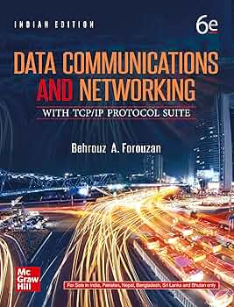


Reference Books:

Slide 13
Assessment Tools

Slide 14
Teaching Learning Method
COs | Teaching-Learning strategy | Assessment strategy
CO1 | Lectures, Power Point Slide, Book | Class Test
CO2 | Lecture Slides, Interactive Discussion, Assignments | Mid-term exam
CO3 | Lectures Slides, Hands on class work, Interactive Discussion | Final Exam

Slide 15
Course Conducting/Course Policies:
It is the student’s responsibility to gather information about the assignments and covered topics if he/she does miss the lecture.
Regular class attendance is mandatory. Points will be taken off for missing classes.
Without 50% of attendance, sitting for the final exam is NOT allowed.

Slide 16

Course Conducting/Course Policies:
The students must enter the classroom in time to get the attendance. No student will be allowed to enter the classroom after the attendance has been done.

Slide 17

Course Conducting/Course Policies:
Once the attendance is done, a student can leave the class if he or she thinks that he or she is not getting benefits from the class
The reading materials for each class will be available at the above-given link before that class.

Slide 18

Course Conducting/Course Policies:
Each student will have to present an oral presentation for 5 minutes on Communication Engineering related recent developments, topics or technologies.
It is expected that the student will also provide some new knowledge related to the curriculum and then make the class a place of knowledge sharing among all participants, both teachers and students.

Slide 19

Course Conducting/Course Policies:
Any attempt at unfair means in the examination is strictly prohibited.

Slide 20
Course Conducting/Course Policies:
The date and syllabus of quiz/class test will be announced in time in Microsoft Team
Students will be notified in due time for class cancelation, extra class, make-up class and tutorial class.

Slide 21

Course Conducting/Course Policies:
Students are encouraged to participate in the class discussion and to ask questions. The student can ask any question without hesitation as long as they cannot understand the topics being discussed. Please keep in mind that if you don’t understand, it’s not your fault; it’s my limitation that I couldn't make you understand. The class is expected to be interactive.

